Slide 1
Academic Publishing
Dirk Riehle, Univ. Erlangen
NYT C13
Licensed under CC BY 4.0 International

Slide 2
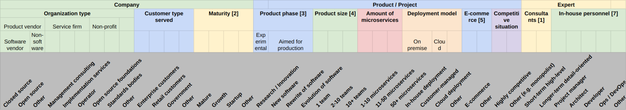
Example Sampling Model for Microservice Integration
Interview study for microservice integration
Population = people related to microservice integration
Alternative: Companies employing microservice-based architectures

Slide 3
Agenda
Research publications
Journal publications
Conference publications
Other types of publications
The peer review process
The journal review process
The conference review process
The publishing business

Slide 4
1. Research Publications

Slide 5
Why Publish Research Papers?
I publish, therefore I am
To advance science
To have a career

Slide 6
Status Hierarchy of Publications by Degree of Peer Review
The general status hierarchy
Journal articles [1]
Conference papers
Workshop papers
Technical reports
as determined by diligence and depth of peer review
In practice, there are significant quality differences between
journals and journals
journals and conferences
[1] In computer science, conference can have equally serious peer review

Slide 7
The Purposes of Academic Communication
The purposes of public written academic communications include
Documentation and communication of
Early (workshop papers)
Intermediate (conference papers)
Final (journal articles)
Scientific results
Exchange of ideas, public conversation
Documentation of supplementary results (technical reports)
[1] In computer science, conference can have equally serious peer review

Slide 8
Academic Evaluation
Evaluation of researchers, departments, and universities is strongly tied to their research publications
Researchers get evaluated for promotion (tenure)
Department rankings influence student choice
University rankings influence public funding
Publication value is measured by
Value of the publication venue
Common measure: Impact factor
Citations of publication
Common measure: Weighted counts
Also see the SF Declaration of Research Assessment (DORA) [1]
[1] See https://sfdora.org/

Slide 9
Publication Strategy
Quality over quantity
Slice work as small as you can while you still reach the best possible journal

Slide 10
2. Journal Publications

Slide 11
Publishing in Journals
Journals are
(Usually) regularly appearing article collections with
No specific submission deadline (submit at any time) but
Uncertain publication date (when your time has come) and
Possibly multiple iterations before a final decision

Slide 12
Organizational Structure of a Journal
Editor-in-chief
Associated editor (a.k.a. area editor)
Reviewer

Slide 13
Software Engineering Journals
ACM Transactions on Software Engineering Methodology
IEEE Transactions on Software Engineering
Empirical Software Engineering (Springer)
Requirements Engineering (Springer)

Slide 14
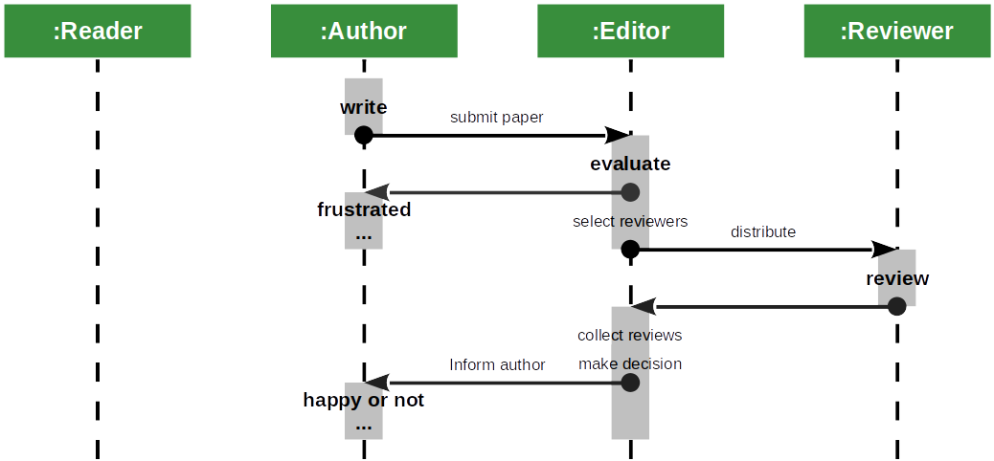
Submission and Review Process

Slide 15
Reviewer Response Categories
Accept
Accept with minor revisions
Major revision / revise and resubmit
Reject

Slide 16
Resubmission and Response to Reviewers
When faced with a revise-and-resubmit
Prepare new manuscript expediently
Write separate response-to-reviewers

Slide 17
3. Conference Publications

Slide 18
Publishing at Conferences
Conferences are
Community gathering events where
Research work is being presented next to
Various other forms of professional communication
Conference papers are
Research papers accepted for
Presentation at the conference and
Publication in the conference proceedings
Conference proceedings are
Research paper compendia associated with the event and
Typically are published once a year
Have a single submission deadline and a
Fixed publication date (the conference start)

Slide 19
Organizational Structure of a Conference
Conference committee
Program committee
Program committee chair
Program committee members (reviewers)

Slide 20
Software Engineering Conferences
ACM Foundations of Software Engineering (FSE)
European Software Engineering Conference (ESEC)
IEEE International Conference on Software Engineering (ICSE)

Slide 21
Reviewer Response Categories
Accept and champion
Accept but do not champion
Reject but do not detract
Reject and detract

Slide 22
4. The Peer Review Process

Slide 23

The Hallmark of Science

Slide 24
Peer Review
Peer review is
The process of providing quality assessments about scientific work by
Having other scientists provide an analysis and opinion of the work
Science’s final quality assurance measure
Evidence-based science vs. “eminence-based” science
Collaborative decision making is typically superior to an individual’s one
Applies to medicine, aircraft piloting, and science in general

Slide 25
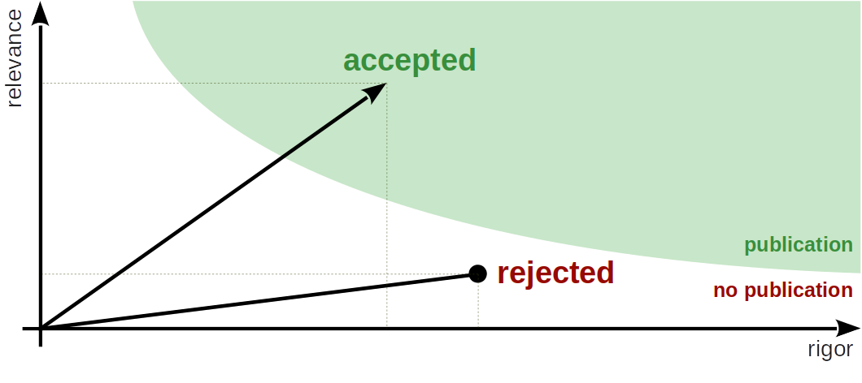
Rigor vs. Relevance (Recap)

Slide 26
Questions on a Reviewer’s Mind
Rigor: Is this valid work?
Is the claimed contribution real?
Do they know and use methods properly?
Do they understand the limitations of their research?
Relevance: Does this work matter?
Is the addressed problem real?
How significant is their problem?
How significant is the progress achieved?
Social factors: How do they relate?

Slide 27
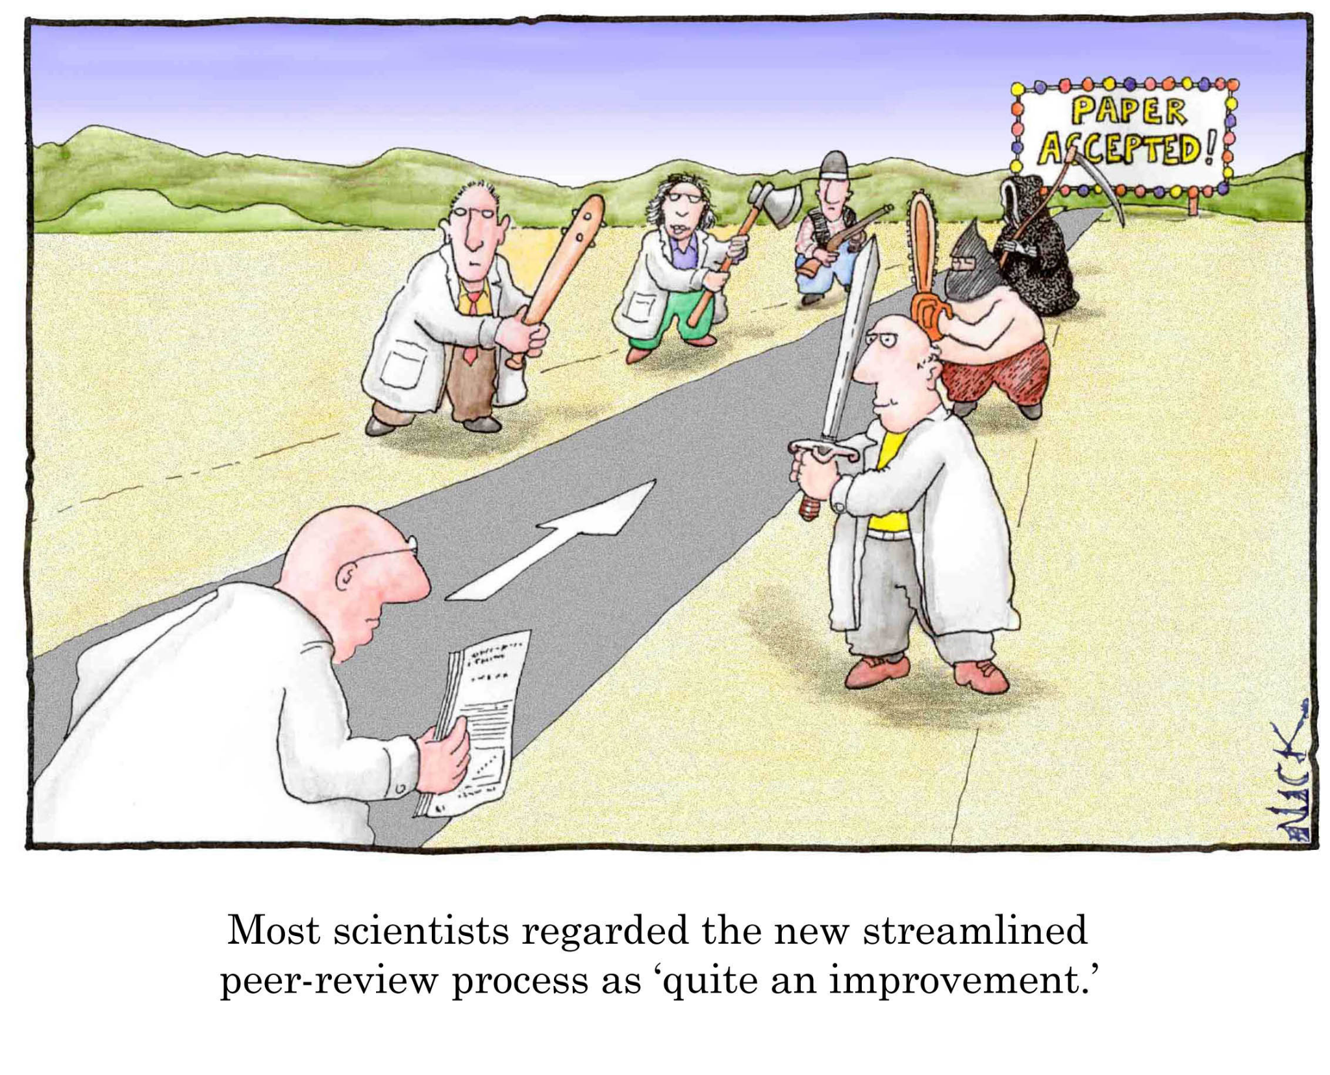
Constructive vs. Antagonistic Reviews

Slide 28

Peer Review is Not Perfect
But the best we have

Slide 29
5. The Publishing Business

Slide 30
Publishing is a Business
Non-profit academic publishers
ACM
IEEE (mostly)
For-profit publishers of academic research
Elsevier
Springer
Revenue sources are
Subscriptions to (digital) libraries
Individual article access fees

Slide 31
What Publishers Do
The product
Provide access to archival publications
In various forms
Their service
Process coordination
Editing and publishing

Slide 32
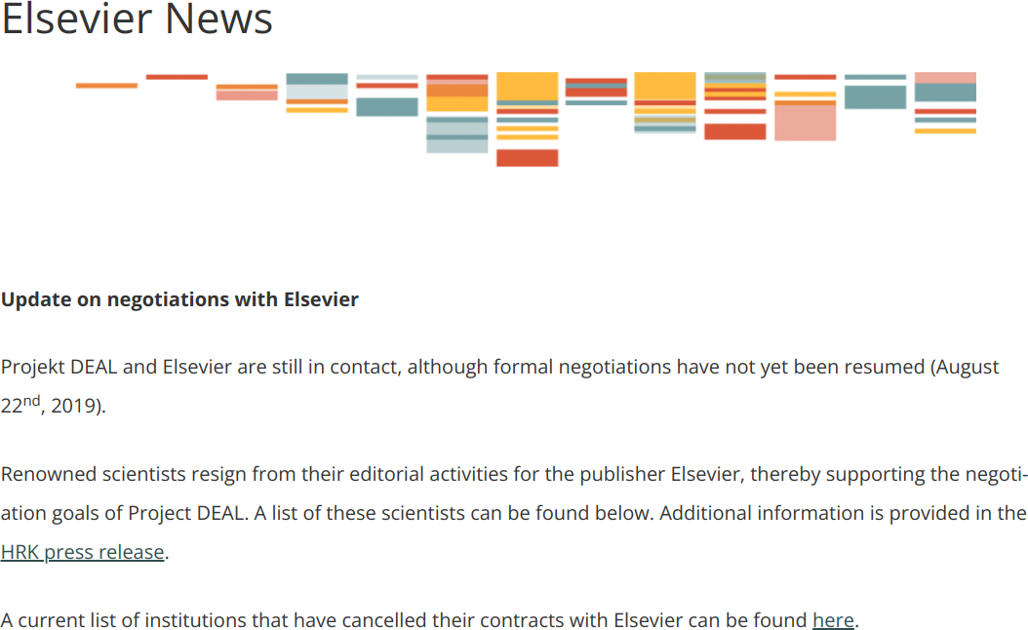
Elsevier is Holding Research Results Hostage [1]
[1] See https://www.projekt-deal.de/elsevier-news/

Slide 33
Three Eras of Publishing
First era (mostly gone, but not fully)
Authors paid publishing fees, subscribers paid subscription fees
Second era (until recently, still going on)
Authors do not pay anything, subscribers pay subscription fees
New open access era (expanding)
Authors pay publication fees, access to article is free

Slide 34
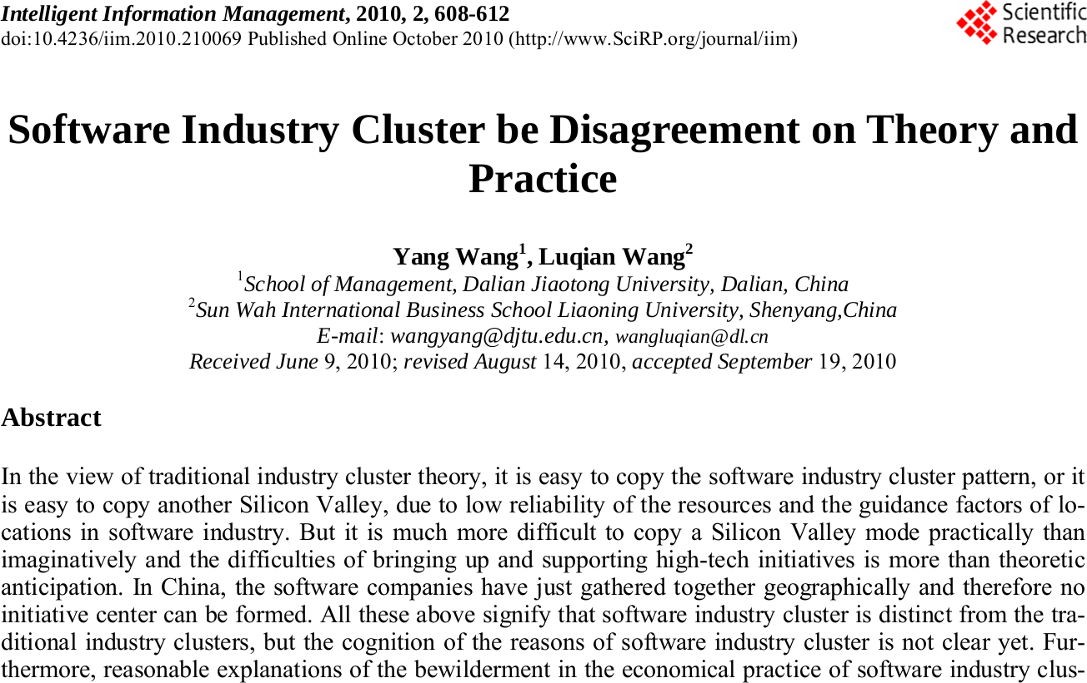
The Rise of Predatory Publishers

Slide 35
Thank you! Any questions?
dirk.riehle@fau.de – https://oss.cs.fau.de
dirk@riehle.org – https://dirkriehle.com – @dirkriehle

Slide 36
Legal Notices
License
Licensed under the CC BY 4.0 International license
Copyright
© Copyright 2022 Dirk Riehle, some rights reserved

